Slide 1

BLG 561E Deep Learning
A NOVEL CNN ARCHITECTURE TO DIAGNOSE PNEUMONIA AND ITS CAUSES FROM CHEST X-RAY
FINAL PROJECT
Ozan Güldali - 509191238
Cihat Kırankaya - 507192112
Notes:
Hi everyone, we want to present our study about A NOVEL CNN ARCHITECTURE TO DIAGNOSE PNEUMONIA AND ITS CAUSES FROM CHEST X-RAY

Slide 2

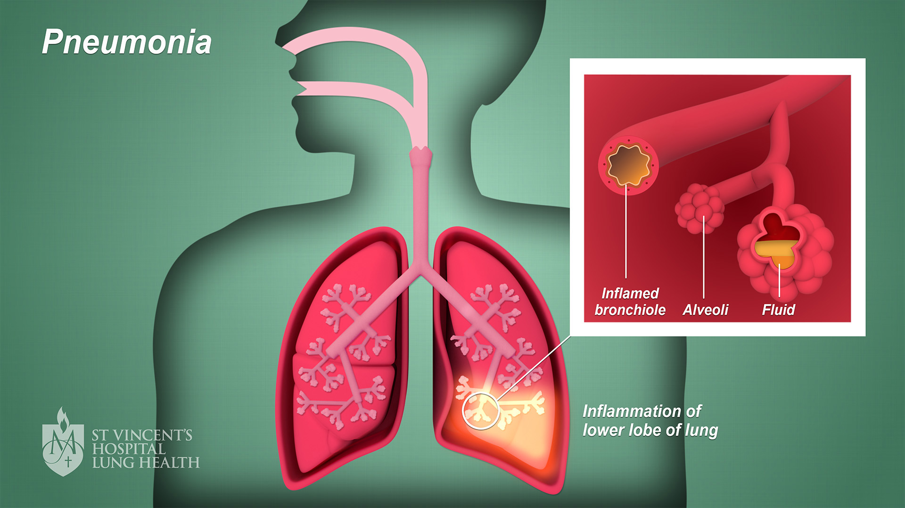
What is the problem to solve and why?
Pneumonia is an infection that makes breathing difficult when the lungs are filled with various fluids. Symptoms include severe shortness of breath, chest pain, chills, cough, headache, fever, and tiredness. Community-acquired pneumonia is still a recurrent cause of mortality.
Deep learning has been an essential imaging method that helps the diagnosis and management of patients with COVID-19 and bacteria borne pneumonia.
Notes:
Pneumonia is a common and serious lung disease caused by viruses and bacteria.
COVID-19 has infected more than 85 million people worldwide, killed 1.85 million and is still spreading rapidly around the world. It is important to detect COVID-19 as quickly and accurately as possible in order to control the spread of the disease and treat patients. The increase of these COVID-19 cases is considered to have a major impact on the increase of Pneumonia disease. It had been realized that from a clinical point of view the COVID-19 and bacterial infection caused clusters of fatal pneumonia.

Slide 3
Augmented Dataset
Class | Original Set | Training Set |  | Testing Set
 |  | Chosen | After Augmentation
Normal | 1576 | 240 | 240 | 80
Bacterial | 2772 | 240 | 240 | 80
Viral-Covid | 58 | 40 | 240 | 18
Viral-Other | 1493 | 240 | 240 | 80
Total | 5899 | 760 | 960 | 258
The dataset totally has 960 training and 258 testing samples. The training data was shuffled on each epoch during experiments.
The chosen Viral-Covid labeled training data has been augmented by horizontal flip, vertical flip, 90 degrees rotation, 180 degrees rotation and 270 degrees rotation.
Notes:
The four main classes were considered on the given dataset such as healthy people (normal), bacterial pneumonia patients (bacterial), COVID-19 pneumonia patients (viral-covid) and other viral pneumonia patients (viral-other). The dataset was constructed by choosing 240 samples for training and 80 samples for testing from each of Normal, Bacterial and Viral-Other labels of the given original data. From the Viral-Covid labeled data, 18 samples were chosen for testing, and 40 samples were chosen for training and then each Viral-Covid training datum was augmented 5 times.

Slide 4
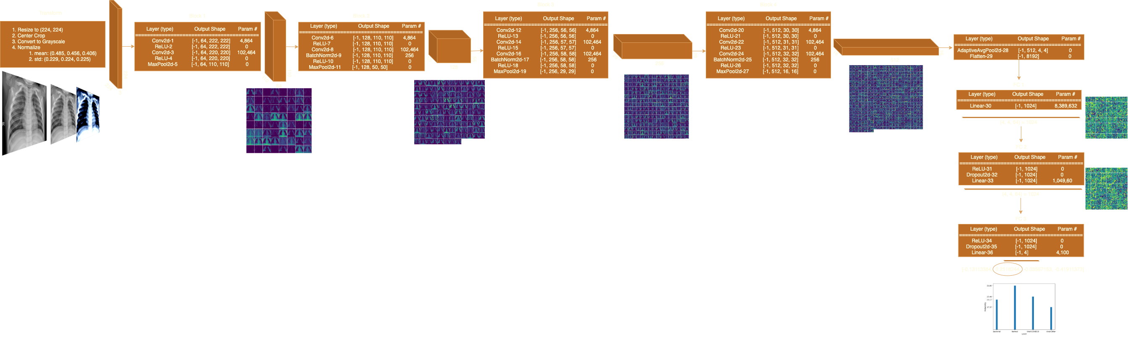
What is the solution and hypothesis?
Notes:
The aim of this study is to propose a new model for the efficiently diagnosis of pneumonia from Chest X-Ray data and compare the proposed model with the most used models. A new CNN model has been proposed for the detection of Pneumonia disease for 4 different classes. For this aim, ProposedNet architecture was designed by determining the most appropriate hyperparameters. The proposed model consists of four convolutional layers with different hyperparameters for Relu, max pooling, batchnorm processes. In addition, there are three fully connected layers in the model. It has been used ResNet50, AlexNet and SqueezeNet1_1 pre-trained models to obtain a higher prediction accuracy for dataset. In addition, the diagnosis of pneumonia was conduct with CovidNet, DarkCovidNet and NovelNet, which are successfully used in the literature for COVID-19 classification, and compared with the proposed model. To improve the success percentage and extract deep features of the proposed model, then the features were inserted into SVM algorithms to final classification.

Slide 5
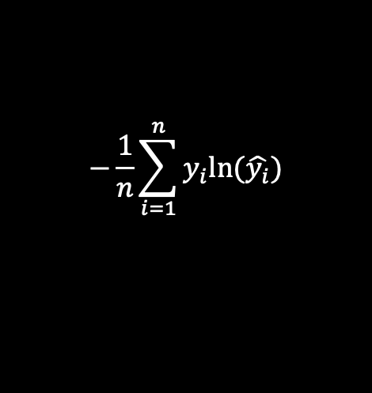
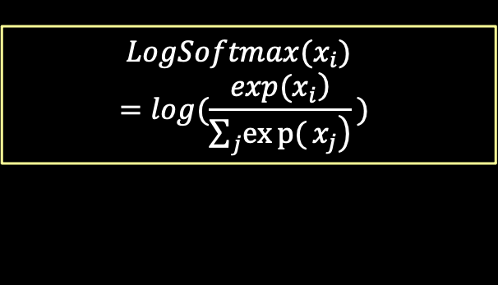
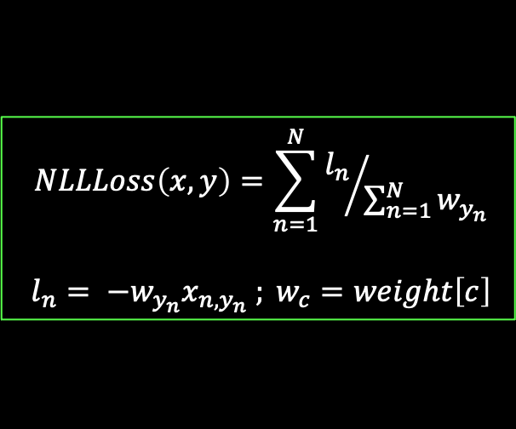
Objective function
$$NLLLoss\left(x,y\right)=\sum_{n=1}^{N}{{l_{n}}/{\sum_{n=1}^{N}{w_{y_{n}}}}}$$
$$l_{n}= −w_{y_{n}}x_{n, y_{n}} ; w_{c}=weight\left[c\right]$$
$$−\frac{1}{n}\sum_{i=1}^{n}{y_{i}ln(\hat{y_{i}})}$$
$$LogSoftmax(x_{i})=log(\frac{\left.exp(x_{i}​\right)}{\sum_{j}{\left.exp{(}x_{j}\right)}}​)$$
Take the average across observations for each minibatch to compute the final loss function
Notes:
1.2.3. Cross-Entropy as the combination of Log SoftMax and Negative Log-Likelihood Loss was chosen to be the objective loss function on proposed CNN models. Each estimated class likelihood is compared to the target performance 0 or 1 of the actual class, and a loss is determined that penalizes the probability depending on how far the real expected value is formed.

Slide 6



How to optimize the objective function?
Adam
SGD Momentum
AdamW
$$g_{t}=∇_{θ}f_{t}(θ_{t−1})$$
$$m_{t}=β_{1}m_{t−1}+(1−β_{1})g_{t}$$
$$υ_{t}=β_{2}υ_{t−1}+(1−β_{1})g_{t}^{2}$$
$$θ_{t}=θ_{t−1}−η\frac{{m_{t}}/{\left(1 − β_{1}^{t}\right)}}{\sqrt{{v_{t}}/{\left(1 − β_{2}^{t}\right)}}+ε }$$
f : loss function
$$β_{1,2}:momentum parameters$$
$η$: initial learning rate
$g_{t}$: gradient at time t along w
$$g_{t}=∇_{θ}f_{t}(θ_{t−1})$$
$$m_{t}=β_{1}m_{t−1}+(1−β_{1})g_{t}$$
$$υ_{t}=β_{2}υ_{t−1}+(1−β_{1})g_{t}^{2}$$
$${\hat{υ}}_{t}=max⁡({\hat{υ}}_{t−1}, v_{t})$$
$θ_{t}=θ_{t−1}−η\frac{{m_{t}}/{\left(1 − β_{1}^{t}\right)}}{\sqrt{{v_{t}}/{\left(1 − β_{2}^{t}\right)}}+ε }+ wθ_{t−1}$
f : loss function
$α$: weight decay
$η$: initial learning rate
$$β_{1,2}:momentum parameters$$
$$g_{t}=∇_{θ}f_{t}(θ_{t−1})$$
$$υ_{t}=βυ_{t−1}+(1−β)g_{t}$$
$$θ_{t}=θ_{t−1}−ηυ_{t}$$
f : loss function
$η$: initial learning rate
$β$: momentum parameter
Optimizer | Learning Rate | Schedular | Betas | Weight Decay | Momentum
SGD Momentum | 1e-4 | True | (0.9, 0.999) | 1e-4 | -
Adam | 1e-4 | True | (0.99, 0.99) | 1e-4 | -
AdamW | 1e-3 | False | - | - | 0.9
Notes:
In the study, Adam with weight decay, Adam with decoupled weight decay and SGD with momentum were used. The short brief of optimizers can be seen.
Various learning rates, momentum values, betas and weight decay parameters were experimented to obtain the optimal results. The learning rate update was also experienced as reducing the learning rate by 0.1 for each quarter of total epoch size.

Slide 7
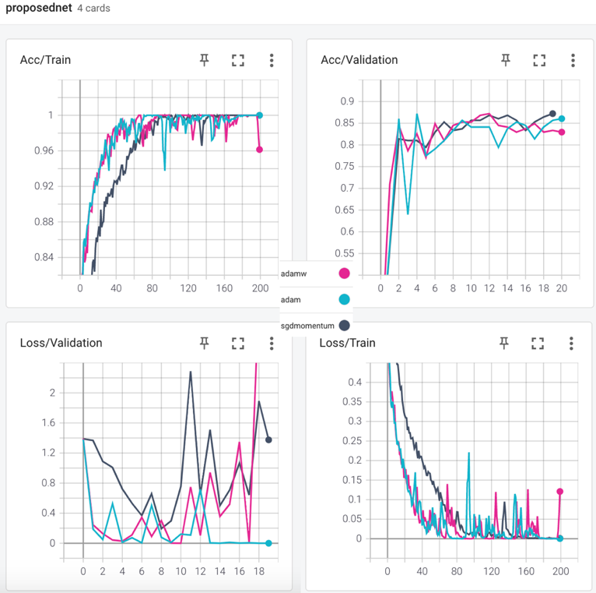
Result interpretation
 |  | Accuracy
Pretrained | Model | Adam | AdamW | SGD Momentum
FALSE | *ProposedNet | 87.21 (40 epochs) | 87.21 (120 epochs) | 87.21 (190 epochs)
FALSE | DarkCovidNet | 84.88 | 86.05 | 83.33
FALSE | CovidNet | 86.04 | 84.88 | 82.55
FALSE | NovelNet | 79.84 | 81.00 | 82.55
TRUE | AlexNet | 82.64 | 84.88 | 86.04
TRUE | ResNet50 | 83.72 | 84.49 | 86.82
TRUE | SqueezeNet1_1 | 83.72 | 84.88 | 75.88
Method | Accuracy (%) | Sensitivity (%) | Specificity (%) | Precision (%) | F1-Score (%)
SVM | 84.65 | 84.84 | 84.86 | 84.43 | 84.49
Pretrained Squeezenet1_1 (AdamW) | 84.88 | 84.88 | 84.98 | 84.65 | 84.65
Pretrained AlexNet (SGD Momentum) | 86.04 | 86.04 | 86.26 | 86.08 | 86.80
Pretrained ResNet50 (SGD Momentum) | 86.82 | 86.68 | 87.02 | 86.93 | 86.70
NovelNet (SGD Momentum) | 82.55 | 82.55 | 82.72 | 82.55 | 82.36
CovidNet (Adam) | 86.04 | 86.04 | 86.26 | 85.88 | 85.76
DarkCovidNet (AdamW) | 86.05 | 86.43 | 86.64 | 86.02 | 86.17
ProposedNet (Adam) | 87.21 | 87.21 | 87.40 | 87.34 | 87.03
SVM with features extracted from ProposedNet weights | 97.95 | 97.94 | 97.97 | 97.94 | 97.94
ProposedNet (Adam) | Actual Class
Predicted Class | Class | Bacterial | Normal | Viral-Covid | Viral-Other
 | Bacterial | 61 | 1 | 0 | 6
 | Normal | 6 | 77 | 0 | 4
 | Viral-Covid | 1 | 1 | 17 | 0
 | Viral-Other | 12 | 1 | 1 | 70
SVM with deep features | Actual Class
Predicted Class | Class | Bacterial | Normal | Viral-Covid | Viral-Other
 | Bacterial | 30,9 | 0,1 | 1 | 0,8
 | Normal | 0,1 | 31,7 | 0 | 0,2
 | Viral-Covid | 0,1 | 0,1 | 25,7 | 0
 | Viral-Other | 0,9 | 0,1 | 0,1 | 31
Notes:
To compare the efficiency of ProposedNet, we obtained results from recently proposed models NovelNet, CovidNet, Dark CovidNet and pretrained models AlexNet, ResNet50, SqueezeNet1_1. Different models reached their best accuracies on different hyperparameters settings and with different optimizers.
It can be seen from the table that the best result was obtained faster by using Adam in ProposedNet model with the accuracy of 87.21% and the AUC Score of 0.96.
To solve the problem of four class classification on pneumonia disease with the highest and useful result, we collected the deep features of dataset from the FC-2 layer of weighted ProposedNet. Then SVM was experienced and performed as explained as you can see.
The satisfying result was obtained as the accuracy of 97.95% and AUC score of 0.995.
As can be confirmed from the tables here, the proposed model has high sensitivity, specificity, precision and F1 score values.

Slide 8
Recap
Pneumonia is a common and serious lung disease caused by viruses and bacteria. Since the emergence of COVID-19 and before, it has been widely used to quickly and efficiently diagnose pneumonia caused by COVID-19, bacteria and other viruses using chest X-rays and deep learning techniques.
It has been defined the problem as 4-class classification on pneumonia disease and proposed a novel CNN model named as ProposedNet regarding to the defined problem. In the experiments, the best result was obtained from the proposed model.
With this proposed model and methodology, the pneumonia and its cause can be detected automatically and quickly.
The proposed CNN model ProposedNet, with the beneficial usage example observed on this study, is a significant contribution to the literature for the diagnosis of pneumonia disease.
Notes:
Since the whole world is facing COVID-19 disease, serious increases have been observed in the cases of virus and bacterial pneumonia. Therefore, it is extremely important to diagnose pneumonia automatically using tomography data and without human error. In the study, A new model was proposed to solve the problem mentioned in the study. In order to test its robustness and effectiveness, the results were compared with other models used in the literature and pre-trained models. In the results, it has been observed that the proposed model gives better results than all other models. In future studies, the similar multiclass problems on Chest X-Ray can be experimented with the ProposedNet and with the similar methodology used in this paper for final results.

Slide 9
THANK YOU!

